Slide 1
Mobilities: Discover your opportunities to go abroad
Seminar for PhD students 26.10.2022
Faculty of Science MU

Slide 2
WHY? WHY NOT!

Slide 3
WHY?
WHY NOT?
A unique experience that will give you an insight into living and studying/working abroad
Gain a competitive advantage on the job market
The uniqueness of staying abroad
New approaches and methods, broaden your horizons in your field
Improving your language skills
Creating new contacts, international connections
Possibility to choose any place for your stay abroad – an institution you would like to cooperate with in the future
Mandatory stay abroad for at least 1 month ( = 30 days) for all PhD students!
No answer found
Exceptions possible but only in exceptional cases -> family/healh issues/full-time work and combined form of studies,... Discuss it in advance with your supervisor and Head of the doctoral board
!

Slide 4
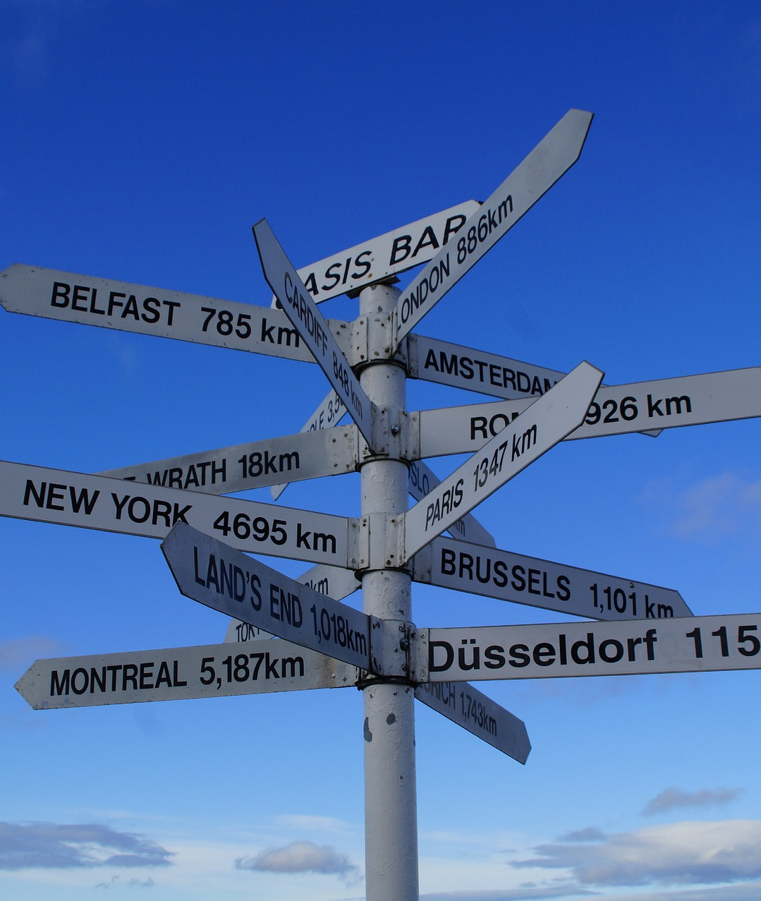
Types of stays - 2 main options:
Study stays – not very usual in the framework of doctoral studies, mainly relevant for BSc and MSc students
Most often Erasmus+, Erasmus+ ICM, Partner Universities ...
Takes place at the university - the choice of university depends on our current contracts
At your chosen university you will attend their classes, enrol in courses and complete them
Usually, 1-2 semesters + 20 ECTS min. for 1 semester

Slide 5
75 % of all stays abroad are through Erasmus+ -> higher chance than Freemover
2) INTERNSHIPS
- sometimes also called work placements/practical stays
- Erasmus+ traineeships (60 days +) or Freemovers (30 days +)
- you can go to any institution - e.g. where you would like to work/get some experience one day

Slide 6
Erasmus+ Internships
4 deadlines every year:
Call I: 31 January 2023
Call II: 30 April 2023
Call III: 31 July 2023
Call IV: 31 October 2022
New option for PhD students is beeing prepared – research stays for 30 days -> should be available from 2023, more information coming
for at least 2 months (=60 days)
max. 12 months during studies
Biggest advantage – contact any institution you want to work with
Scholarship (630 or 750 EUR/month) + possibility to get the faculty scholarship as well!
TIP: Even within the EU member states, you can travel to their overseas territories (Reunion, Martinique, Azores, St. Martin, Fr. Guyana, St. Barthélemy ...)

Slide 7
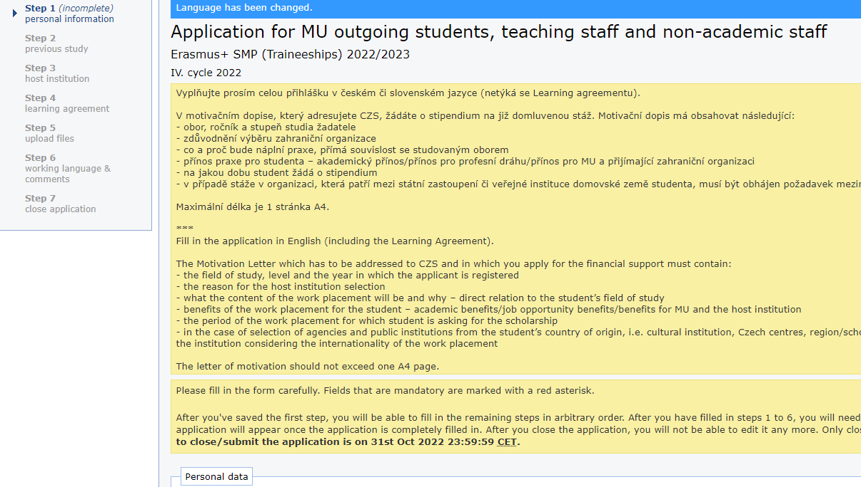
Applications Erasmus+ : ONLINE
In ISOIS
You fill out:
Your personal details
details about your studies
host institution + contact for someone you are in touch with
your MU department coordinator
+ you upload a motivation letter (see next slide)
Then the foreing institution coordinator and the MU department coordinator fill the learning agreement (for traineeships) out online -> they receive an e-mail to do it with all the necessary information
DONE

Slide 8
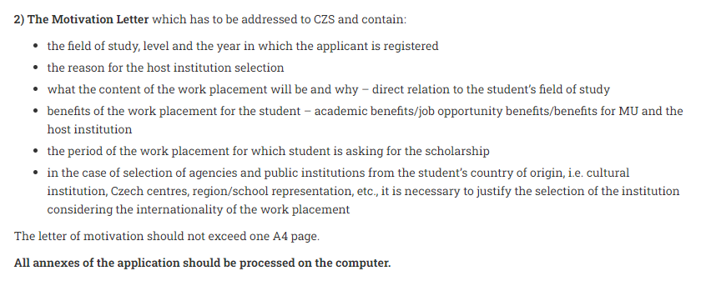
Applications Erasmus+ : ONLINE
Motivation Letter -> What to mention?
It is a mandatory part of your doctoral studies
Who you are, what you study, what you work on
The main goal of the internship -> not only the academic one, but also personal one
Is it a university with good ranking/best in zoology/there is an ongoing cooperation between your department and them?
What to avoid?
AVOID the word research! Use different words (learning new techniques, adquiring new skills…)
too general wording
Forgetting any of the points mentioned above

Slide 9
What if I have just graduated? Can I still go abroad?
Insert any photo of a recent graduate:
Sure! You can use Erasmus+ Graduate work placement
the work placement can newly take place also within 12 months after graduation (including the placement period)
student becomes graduate on the day of successfully passing the dissertation defence– the work placement must start and end within exactly one year starting from this day
the work placement might take 2-12 months where every previous Erasmus mobility within the specific study cycle reduces this period (this concerns the study cycle during which a work placement application is submitted – so if you have already spent 3 month on Erasmus+, you have 9 months left)
IMPORTANT: participant must successfully pass the selection procedure BEFORE his/her graduation, ie. before the date of the dissertation defence

Slide 10
Freemover
Study stays
Each university has different rules. Some freemovers are not accepted at all, in some cases they require tuition fees. In all cases, it is up to the decision of the university whether or not they are interested in accepting the student.
The student must bring 20 ECTS per semester from abroad, the number of credits earned may be lower in the case of short-term thesis preparation, and the student must meet the study requirements of the home faculty.
A letter of acceptance /e-mail is required in the application form.
it is possible to go for shorter stays (1-2 months, for example) to work on a thesis - then the number of credits may be lower
INTERNSHIPS
cannot be used for graduate stays = you must be an active student at MU
Any institution you want
Must have Training Agreement already signed to apply
The programme is for students who cannot finance their traineeship through another programme (eg. Erasmus+)
As a freemovers you can travel to any country in the world for your placement, you make your own arrangements
The internship can be one month to one semester long
The amount of the scholarship can be up to 16.000 CZK per month
Deadline: 15.12.2022, webpage here
!!!Need Learning/Training agreement still in paper form + online application in ISOIS

Slide 11
What else?
Partner universities
Only STUDY stays
deadline 15. 12. 2022 for acad. year 2023/2024
full offer on CZS website (eg. Australia, Brazil, China, Georgia, Israel, Japan, Canada, Costa Rica, Mexico, USA…)
for at least 1 semester
estimated amount of the scholarship: + - CZK 20,000 per month
https://czs.muni.cz/en/mu-student/study-placements/partner-universities
ERASMUS+ ICM: - very interesting offer of universities outside the EU (eg. Armenia, Israel, Dominican Republic, Vietnam, Philippines, Albania…)
Only STUDY stays (for PhD students – research stays possible, check the website!)
Scholarship 700EUR/month + travel expenses
deadline 15. 12. 2022 for acad. year 2023/2024
https://czs.muni.cz/en/mu-student/study-placements/erasmus-icm
… and many more here

Slide 12
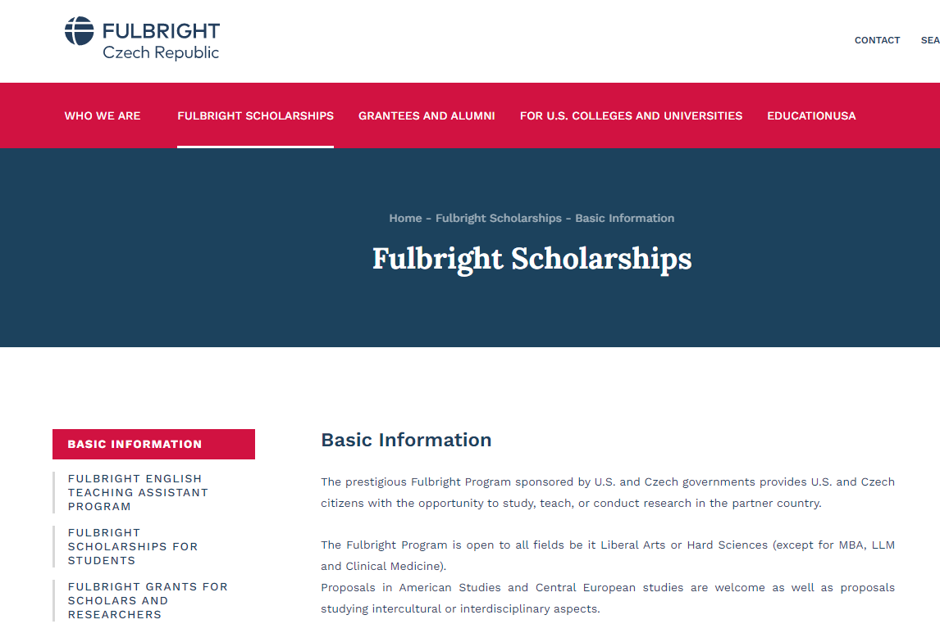
What about UK? USA? Switzerland?
Switzerland
Swiss Government Excellence Scholarships -> info here
Freemover, SEMP scholarship
UK
Freemover
USA
Fulbright: information here
Partner Universities, Freemover or Fulbright

Slide 13
Scholarships (only some options)
Specific scholarship for mobility programme (Erasmus+, Freemover, Ceepus,…)
Faculty scholarship from scholarship programme A.6 - guidelines
Barrande Fellowship Program
Scientific Exchange Grants, EMBO
Attention! Scholarships and travel order/form CANNOT be combined!!!
If you need to top up the travel order/form, let us know in advance.
Tip: try to search also different foundations providing scholarships (Sophia, Open Socienty Fund, Kellner Family Foundation, Bakala Foundation, Foundation for the Development of Education...)

Slide 14
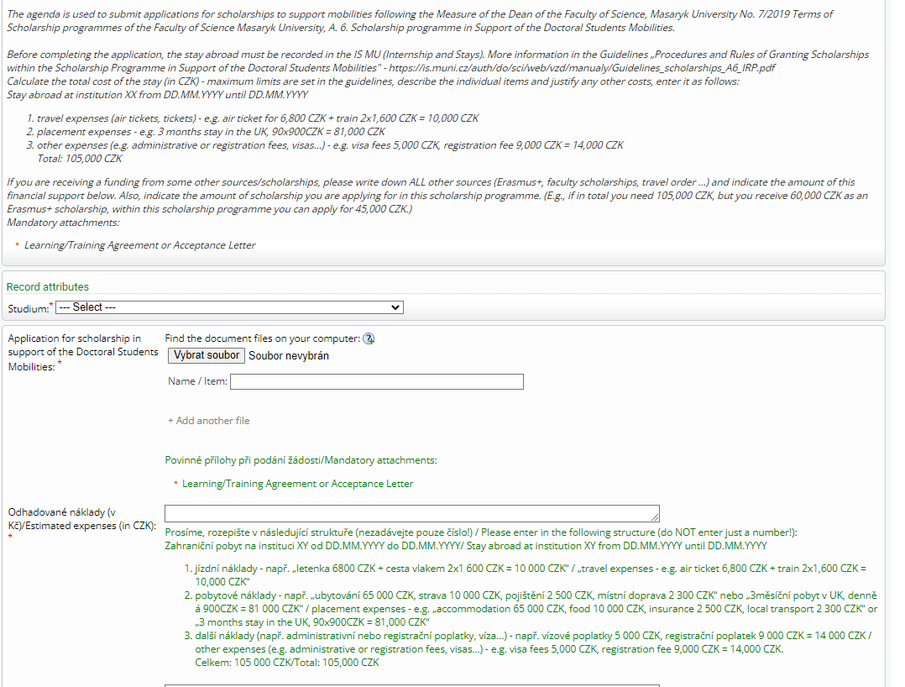
Faculty scholarship A.6
Who? Students in 4+1 years
How much? Depends on the destination and lenght of the stay, up to 100,000CZK
Can I apply repeatedly? Yes, for different stay. Scholarship might be reduced
How do I apply? Electronically in the IS MU (Document Office – Úřadovna) / Guidelines
What do I need? Invitation Letter or Learning/Training Agreement + Record of your stay in the IS
Next year? From January, it will be open again ->you will receive an e-mail!
You can have other scholarships as well -> combination of more sources possible!
Person in charge: Kristýna Bajgarová, bajgarova@sci.muni.cz

Slide 15
What if I am employed?
Employment at SCI MU/CEITEC
Employment at other institutions
Discuss your stay with your immediate superior. If you can work on HO, no problem
Don‘t forget to contact HR
If you need to have a Travel Order/Form (TO) -> you can NOT have an Erasmus+/Freemover scholarship!!! Based on the Czech law, it is not possible to have a scholarship and a money from TO at the same time
ONLY exception -> faculty scholarship from A6 + TO > inform us IN ADVANCE!
You need to choose to have a scholarship or a travel order/form
NO possibility to combine these two financial sources (scholarship + TO)
Applies to ANY scholarship

Slide 16
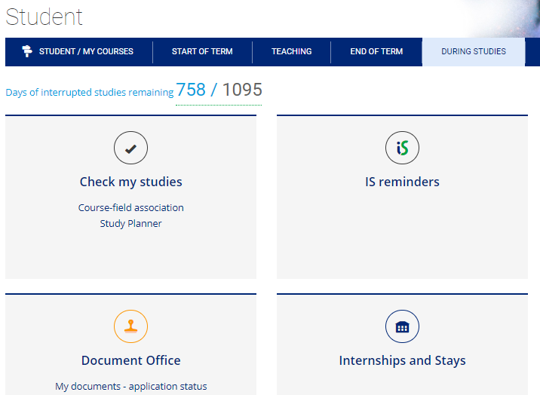
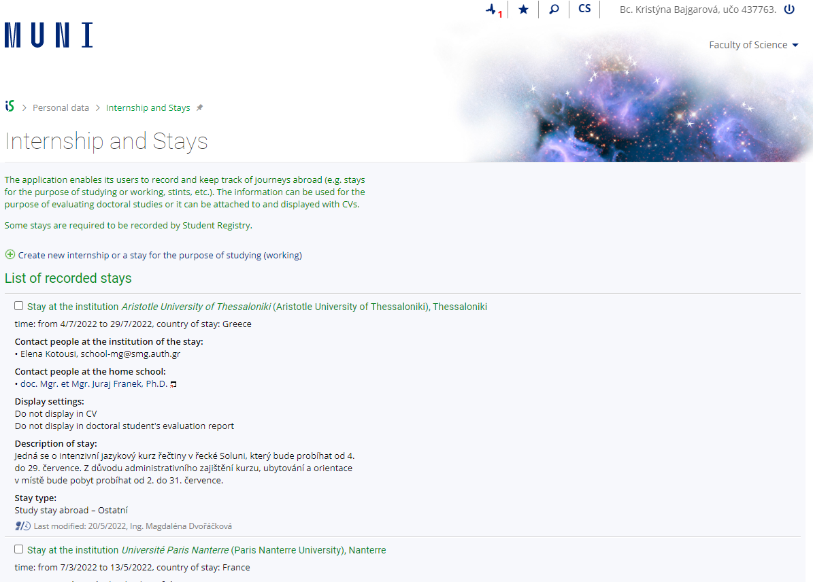
Evidence of your stay in IS
Every placement abroad as part of studies at MU longer than 14 days is considered a study stay or a traineeship. In both cases, this mobility must be part of the study and therefore recognized within the study at MU.
Easy evidence in the IS (Student -> During Studies -> Internships and Stays)
Information here

Slide 17
Recognition of stay
Always done AFTER the stay abroad -> you do NOT enrol any course before going abroad
Different types of documents needed: 1) study stay – Learning Agreement + Confirmation of Studies + Transcript of Records (from the foreign university) 2) internship -> Training Agreement + Confirmation of Placement
Once you have all the documents, you upload them in the IS and follow a step-by-step guide
Create a course (based on LA or TA)
Apply for recognition – last step
NECESSARY to have the stay abroad recognized as mandatory part of your studies -> otherwise, the stay abroad is not counted as a part of your studies!
It takes less than 5 minutes to complete this
Information here

Slide 18
Can I go abroad without using the Erasmus+/Freemover…?
Yes, you can! Contact any institution you want or use your project (IGA, GAČR, TAČR, GAMU,…)
You will need a Training agreement to have the internship recognized into studies.
You can use Faculty scholarship (but please note, you might not receive the full coverage of your stay)
When creating the record of stay in the IS MU -> choose the programme „other“

Slide 19
Where to find information?
Faculty web
Academic Information Agency
Centre for International Cooperation MUNI
MU Portal
Some other scholarship options
Do světa MUNI (so far, only in Czech)
International Office SCI MU (ask us anytime!)
Department coordinators

Slide 20
MU Portal - here
News and interesting offers, all PhD students have access there!

Slide 21
Who can help me? -> Department Coordinators (they work mostly with Erasmus+ programme)
Department of Experimental Biology – Pavel Hyršl (hyrsl@sci.muni.cz) Department of Botany and Zoology – Soňa Hroudová (hroudova@sci.muni.cz) Department of Anthropology – Martin Čuta (cuta@sci.muni.cz) Department of Chemistry –Pavel Brož (broz@chemi.muni.cz) Department of Biochemistry – Jan Lochman (lochik@mail.muni.cz) RECETOX – Tereza Nováková (tereza.novakova@recetox.muni.cz) NCBR (+ Life Science programme!) – Veronika Papoušková (papouskova@ncbr.muni.cz), consultations for Life Science students possible also with Lenka Vivas (Lenka.Vivas@ceitec.muni.cz)

Slide 22
Department of Mathematics and Statistics – Josef Šilhan (silhan@math.muni.cz) Department of Geological Sciences – Adam Říčka (ricka@sci.muni.cz)
Department of Geography – Jarmila Burianová (burianova@geogr.muni.cz)
Department of Condensed Matter Physics – Karel Kubíček (karelk@mail.muni.cz)
Department of Physical Electronics – Zdeněk Bonaventura (zbona@physics.muni.cz)
Department of Theoretical Physics and Astrophysics – Jan Janík (honza@physics.muni.cz)

Slide 23
3 main rules
DON‘T BE AFRAID TO ASK – We‘re here for you!
READ CAREFULLY THE SPECIFIC DETAILS OF EACH SCHOLARSHIP/mobility PROGRAMME to know what you need to do
DON‘T DO IT THE VERY LAST MINUTE
Kristýna -> bajgarova@sci.muni.cz Klára -> klusakova@sci.muni.cz e-mail, MS Teams or in-person consultations possible

Slide 24
Ok, I wanna go. What should I do next?
Discuss it with your supervisor
Browse the web – for example, take a look here or here
TOP 300 world universities (QS ranking)
List of valid contracts (for Erasmus+ study placement etc.)
You can find all the information here (MUNI SCI Student section)
Read this: Mobility process in general
Check MUNI Portal
Check some mobility programme
Be brave and contact any institution you are interested in
Go abroad through the project you are employed at

Slide 25
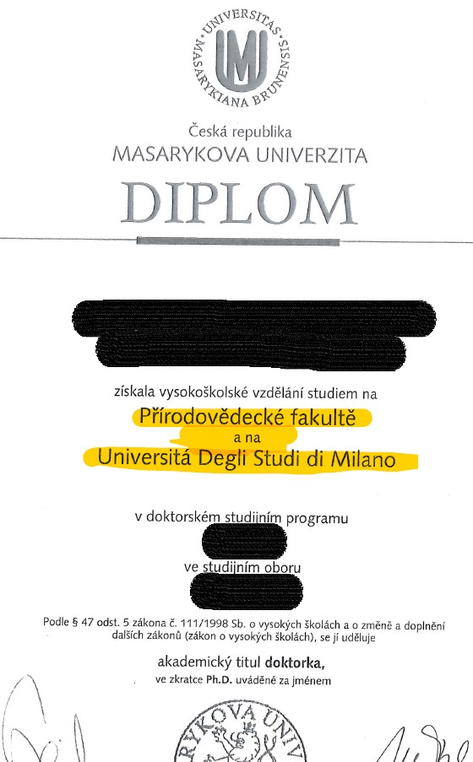
European Doctorate
Documentation detailing the closure of studies in a doctoral programme shall state that studies have been completed in compliance with the requirements necessary for the awarding of a European Doctorate in case the following conditions are met:
a) at least 3 months abroad (cannot be interrupted) at a university located in another European country
b) the candidate submits a doctoral thesis all of which – or at least the introduction, abstract and conclusion – is written in a foreign language, either in English or in the official language of a European country approved by the doctoral board,
c) doctoral thesis reports compiled by at least two thesis reviewers from another European country are presented at the doctoral thesis defence; the supervisor and reviewer must not be active at universities located in the same country,
d) at least one member of the doctoral defence board must be active at a university located in another European country.
Why? Lots of students meet the criteria but do not know ED; simple application. Benefit for future employment/post doc positions -> stated in the diploma
More info in our office – Kristýna Bajgarová, bajgarova@sci.muni.cz
Application at the moment in paper form (will be online in future), need to be submitted after you submit your thesis but before you defend!

Slide 26
Cotutelle
Cotutelle is an agreement about joint supervision on the doctoral level. The cotutelle agreement is individual for each student and is set up between two cooperating institutions, the PhD candidate and the candidate’s supervisors. After having the completed PhD programme, the candidate is awarded a degree from each institution where the institutional cooperation is presented. WHO CAN PARTICIPATE IN A COTUTELLE?
Any full-time student registered in a PhD program is eligible for a cotutelle. Normally, a cotutelle will begin within the first year of your PhD program, but students can enter into cotutelle later, based on mutual agreement of both institutions.
WHY ENTER INTO A COTUTELLE?
A cotutelle provides the PhD candidate with unique international experience and adds an important international dimension to the PhD degree. It lets you enjoy broader and richer scientific support, as well as an international experience.
2in1: Having TWO PhD degrees from two different institutions (two separate diplomas!)
More information: Ms Klára Klusáková, klusakova@sci.muni.cz
+ International cooperation under Ph.D. Guide here

Slide 27
International Relations Common email:
Kotlářská 2, building 1 int@sci.muni.cz room 01006
Kristýna Bajgarová: Klára Klusáková: bajgarova@sci.muni.cz klusakova@sci.muni.cz
Questions?

